Slide 1
PSYC234 Labs week 12 - 13: What happens
In each lab:
  Model summary output… or Model plot…
  …plus dataset
  Sometimes there is a codebook
Look at the model output and construct the model that is shown by:
  working out what the variables are
  maybe doing some cleaning and transformations
  writing the model formula
  interpreting the model summary output or plot
Use the lecture demonstration of the r-script as a template for your own code

Slide 2
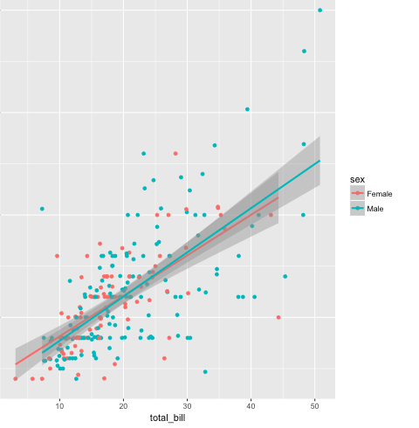
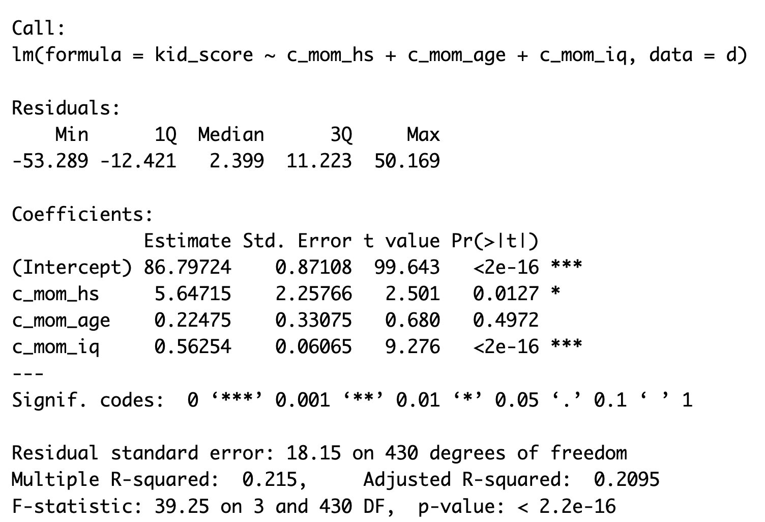
PSYC234 Labs Wk 12 - 13: Example outputs

Slide 3
PSYC234 Labs Wk 14: Mediation
These analyses follow a prescribed number of steps that are performed in a certain order
For this reason, the labs work with a script and task sheet, in a way that you are probably more familiar and comfortable with.

Slide 4
The role of staff in labs
Get us to check your planning / code / answer your questions / listen to your model interpretations
  We will
  identify gaps
  Tell you that there is an error somewhere with an indication of where to look more closely
  Give you hints
  Extend your thinking if you are working at your best level already….
  We won’t
  Give you the answers straight out
    Because most of your project experience is going to be about problem solving

Slide 5
This week: Practice in interpreting multiple regression summary output:

Slide 6
Four parts to a model summary output:

Slide 7




Where do I look and what I am looking for?:

Slide 8
Example output with suggestive reporting text
Text = a paragraph reporting 1) model significance, then 2) coefficients (statistics + verbal description).
Example text for 1) model significance: The model predicting children’s test scores from mother’s graduation status, mother’s age and IQ was significant (F (3, 430) = 39.25, p < .001, R² = 0.21).
Example text for one of the coefficients: ‘c_mom_hs’:
The difference for whether the mother graduated high school or not is significant (b = 5.65, SE = 2.26, p = .013). Holding all other predictors constant, the difference in scores for a child whose mother finished high school and a child whose mother did not finish high school is 5.65 test points.

Slide 9
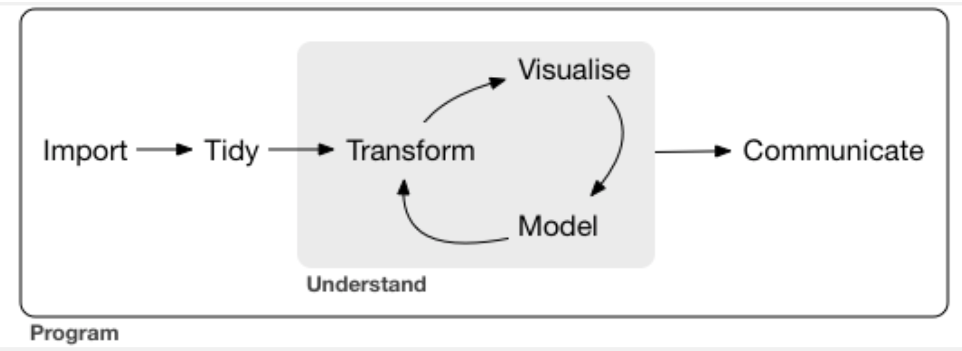
Week 12: Analysing using the workflow

Slide 10
Each stage represents small blocks of code:

